Slide 1


Welcome to Year 6
Class Teacher: Miss Bisley
TAs: Miss Jones & Mrs Pace

Slide 2
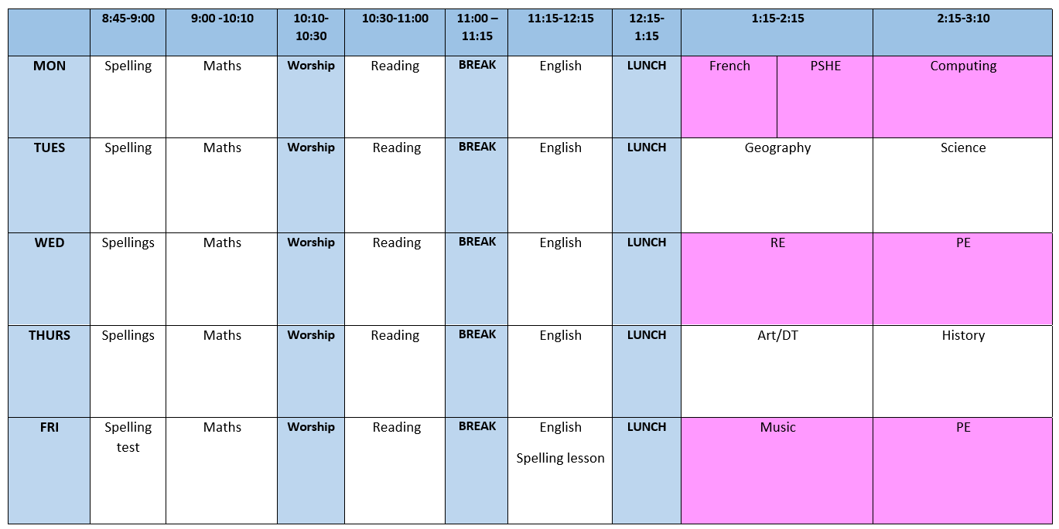
Timetable
PE: Wednesday & Friday

Slide 3

Homework
Weekly expectation:
15 minutes of TTRS a week
Maths task
‘Quick comprehension’ reading task
Friday: Homework Deadline & Set/Spelling Test
Returning homework: children must hand in homework on time failure to do so will result in Friday lunch club.

Slide 4


Reading
Reading is the most important skill we teach at primary school.
In KS2 all pupils will be on a book band. These do not change as quickly as when in KS1.
Please support your child by hearing them read at home and recording this in their reading record.

Slide 5

Curriculum
English: Description (Characters & Settings)
Reading: The Explorer by Katherine Rundell
Maths: Place Value, Operations and Fractions
Geography: South America
History: The Maya
Science: Living things and Their Habitats
RE: Hinduism
Art: Relief painting (Maya inspired)

Slide 6
Pencil Cases
All Key Stage Two pupils are to bring into school their own stocked pencil case. Pencil cases will be kept in your child’s tray so will need to be small and flat.
Please ensure your pencil case includes the following:
· HB Pencils
· White pencil eraser
· Pencil sharpener
· 30cm ruler
· Small selection of coloured pencils
· Whiteboard pens
· Glue stick
· Green biro
· Pair of scissors
· Blue handwriting pen (Year 5/6)
Please ensure that all equipment is labelled with your child’s name to ensure it gets back to them should anything go missing.
Please do check your child’s pencil case at the end of each term in case anything needs replacing

Slide 7
SATS Key Dates
The statutory key stage 2 tests are timetabled from Monday 11th May to Thursday 14th May 2025.
We will hold a SATs information meeting later this academic year.

Slide 8
Secondary School
You can apply from 1st September.
The closing date for West Berkshire applications is 31 October 2025.
Places are offered on Monday 2nd March 2026.

Slide 9
Year 6 Residential
Avon Tyrrell
Dates 29th June – 3rd July 2026
Estimate cost: £470
A deposit of £50 will be needed to secure your child’s place by October 31st. This will be live on ParentMail by the end of this week.
A letter will be sent out with more information and costs.

Slide 10

Walking home
If you would like your child to walk home please go to the office to collect and sign a form.

Slide 11
Phones
If your child brings a phone into school they MUST bring it to the office as soon as they enter the building.
Children will collect their phones at the end of the school day.

Slide 12
Thank you very much for coming, and if you have any questions, please do not hesitate to ask.

