Slide 1

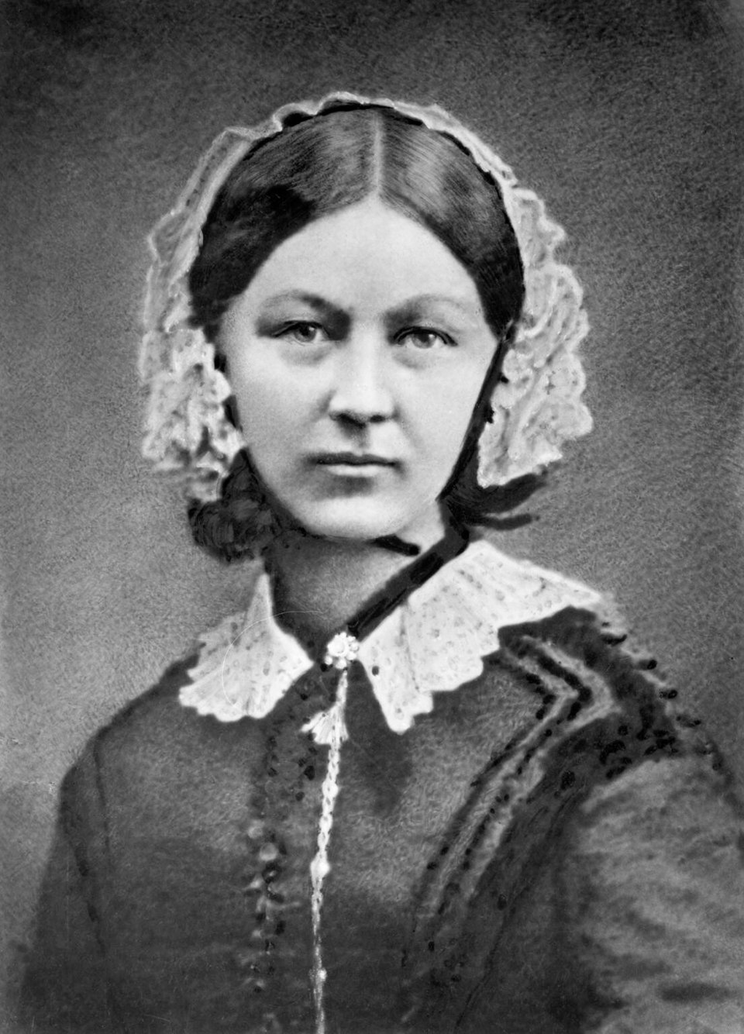
Welcome to Year 3
Class Teacher Miss Whitaker
Class Assistant Teacher: Miss Bishop and Miss Faithfull

Slide 2
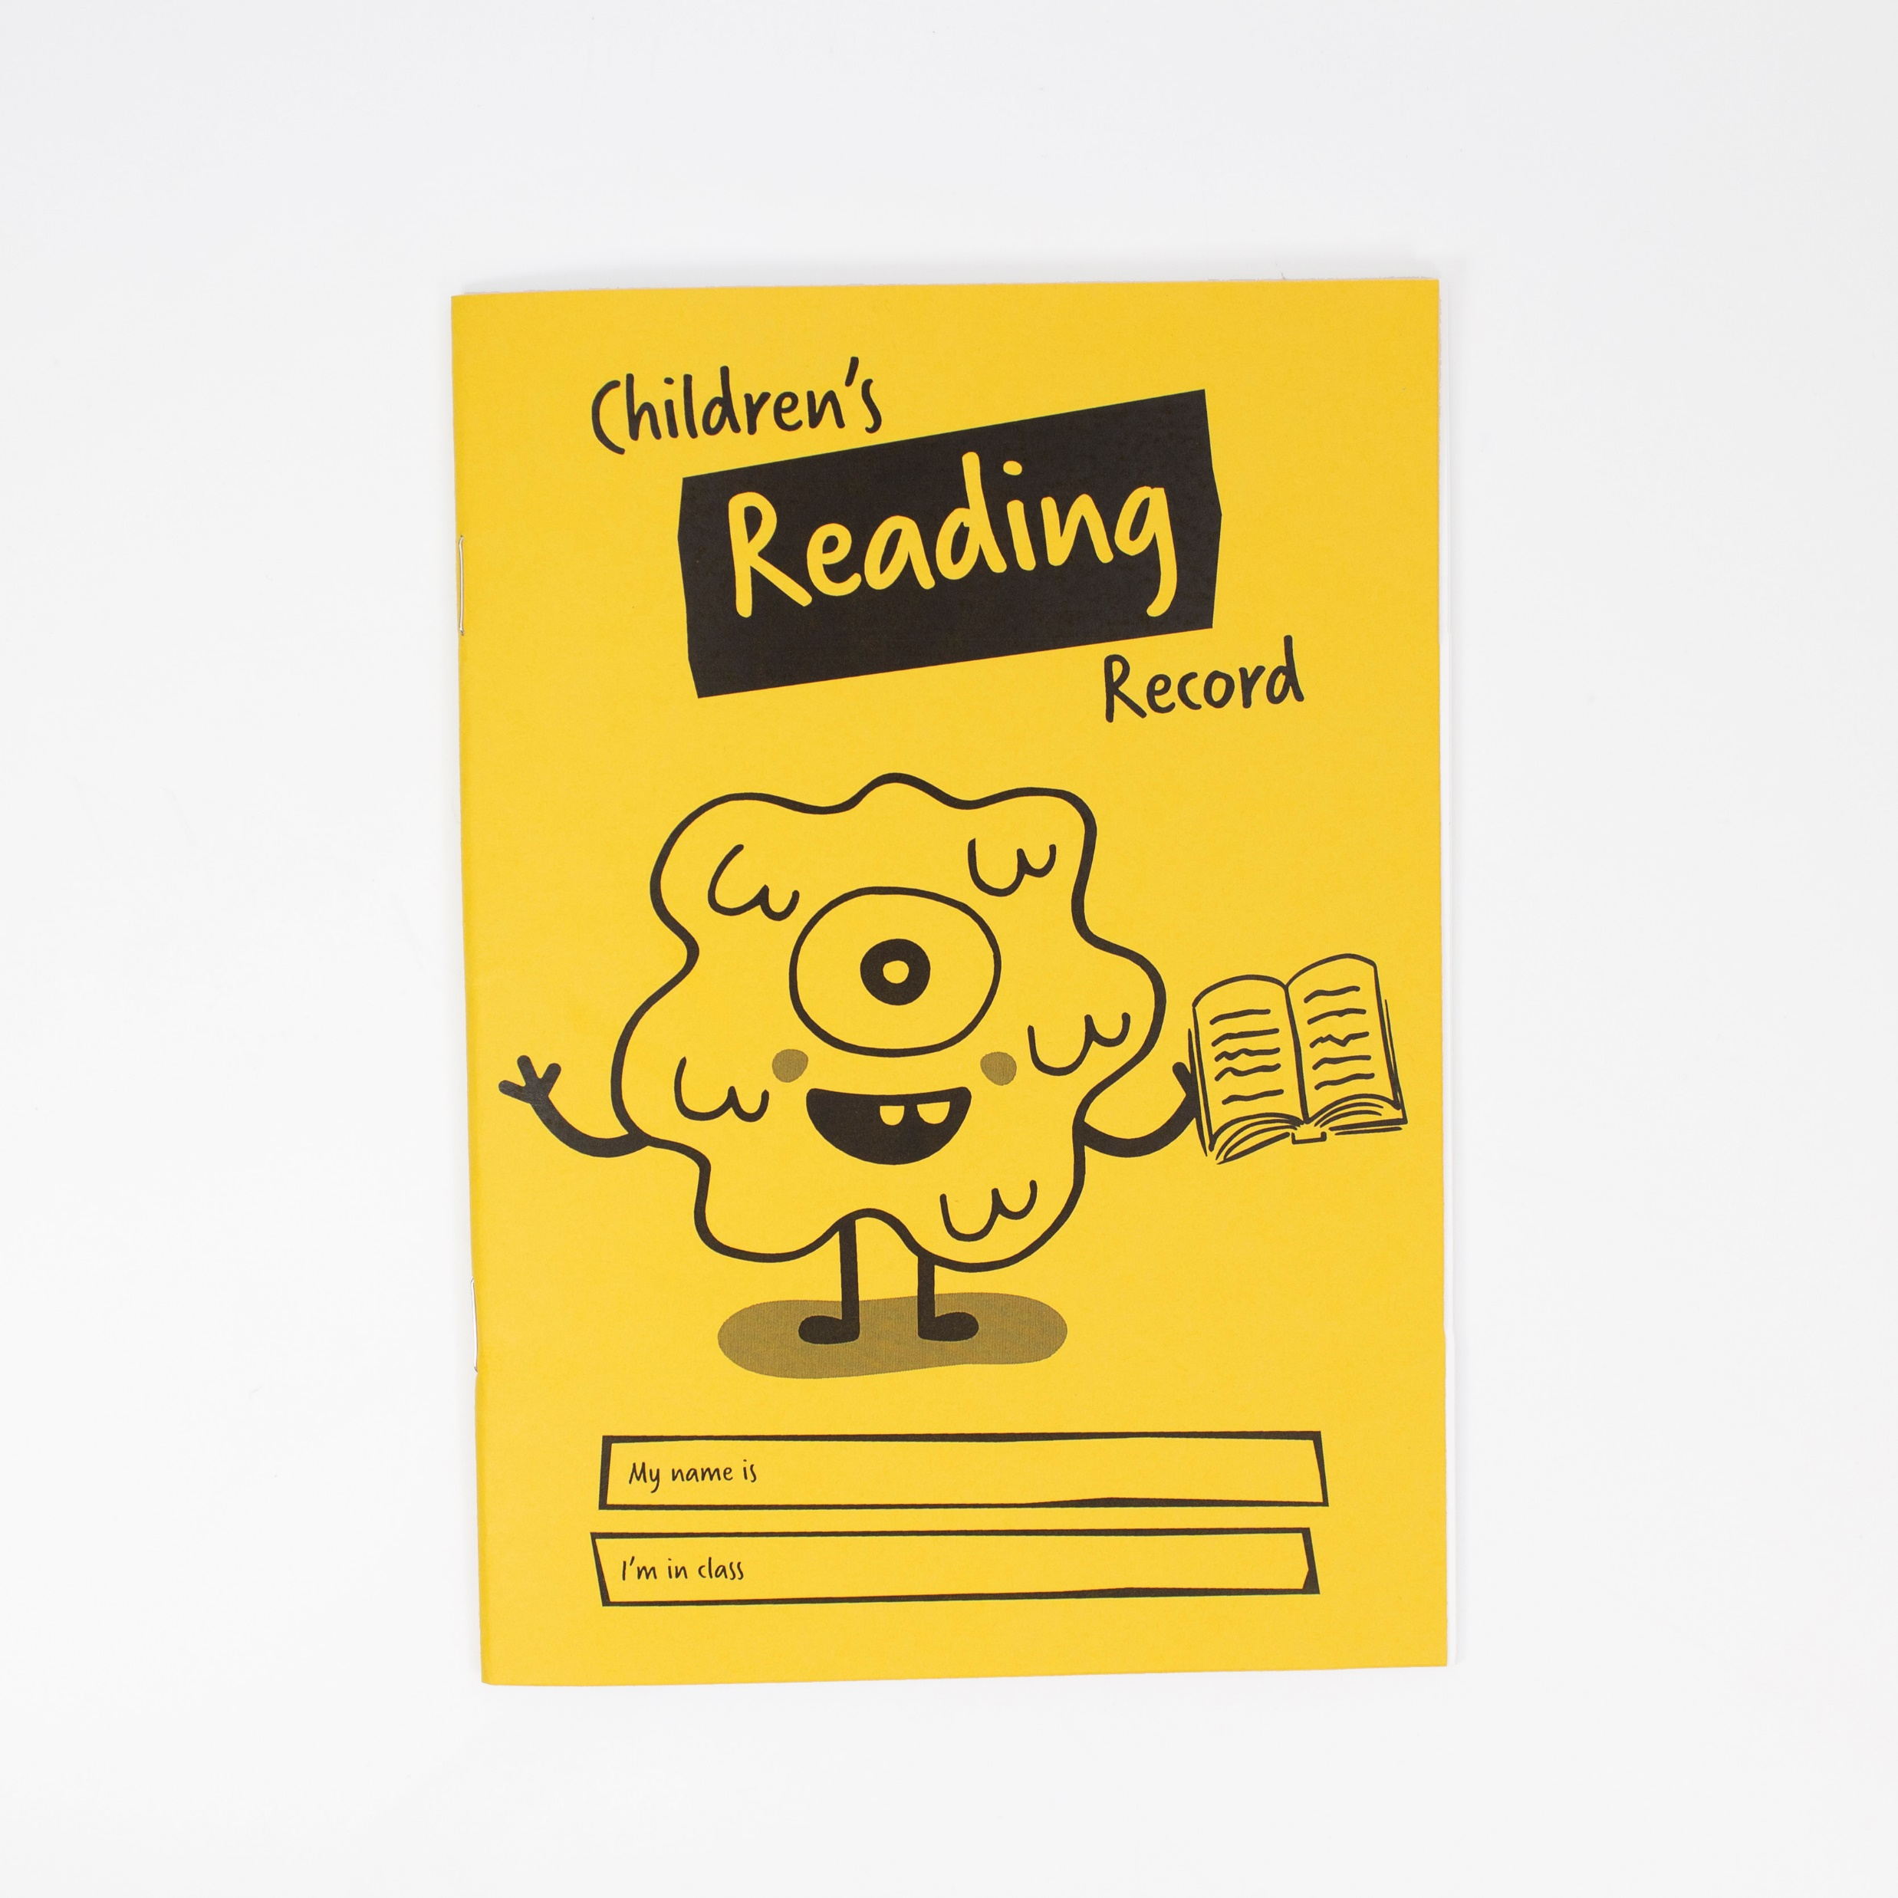

Reading
Reading is the most important skill we teach at primary school.
In KS2 all pupils will be on a book band. These do not change as quickly as when in KS1.
Please support your child by hearing them read at home and recording this in their reading record.

Slide 3
Reading Book Bands
By the end of Year 3, your child should be reading a lime book band book. If the case is that your child surpasses this and moves onto brown then they will be kept on the brown book band and offered a breadth of books. This is because the content in higher level books will be trickier to comprehend.
Year 2 expectation
Year 3 expectation

Slide 4
Curriculum
English: Twisted traditional tales
Reading: The Day I Fell Into a Fairytale by Ben Miller
Maths: Place Value, Addition and Subtraction, Multiplication and Division
Geography: Natural disasters
History: Stone Age, Iron Age, Bronze Age
Science: Rocks and Fossils
RE: Christianity unit – The Creation Story
DT: Seasonal cooking – Fruit Crumble

Slide 5
Pencil Cases
All Key Stage Two pupils are to bring into school their own stocked pencil case. Pencil cases will be kept in your child’s tray so will need to be small and flat.
Please ensure your pencil case includes the following:
· HB Pencils
· White pencil eraser
· Pencil sharpener
· 30cm ruler
· Small selection of coloured pencils
· Whiteboard pens
· Glue stick
· Green biro
· Pair of scissors
Please ensure that all equipment is labelled with your child’s name to ensure it gets back to them should anything go missing.
Please do check your child’s pencil case at the end of each term in case anything needs replacing

